Slide 1
Supplementary Chapter
Microstructure control by varying the local chemistry
Dr. Christian Leinenbach
Prof. Roland Logé

Slide 2
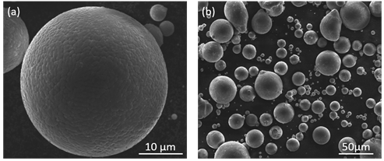
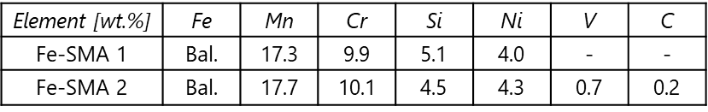
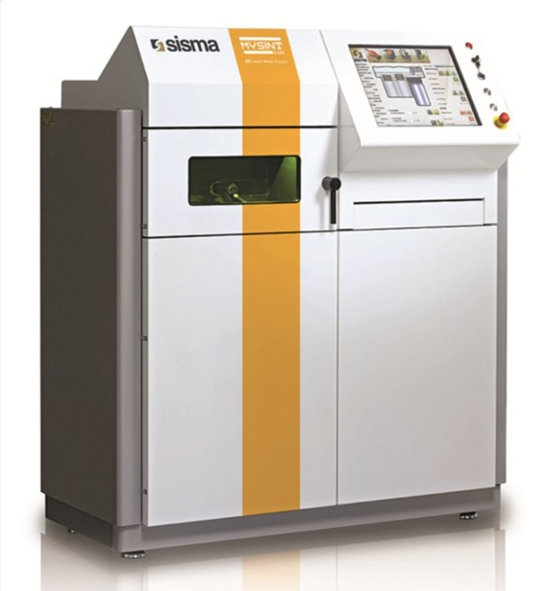
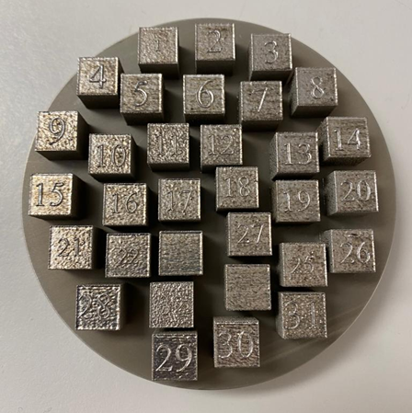


2. Laser powder bed fusion of shape memory alloys
Sample fabrication
Powders
Laser parameters
Thermo-mechanical tests
PE & SME
Tension & Compression
Different sample orientations
w/oVC
w/VC
Build direction
VED = $\frac{P}{v ∗h ∗ t}$ [J/${mm}^{3}$]
Loading direction

Slide 3
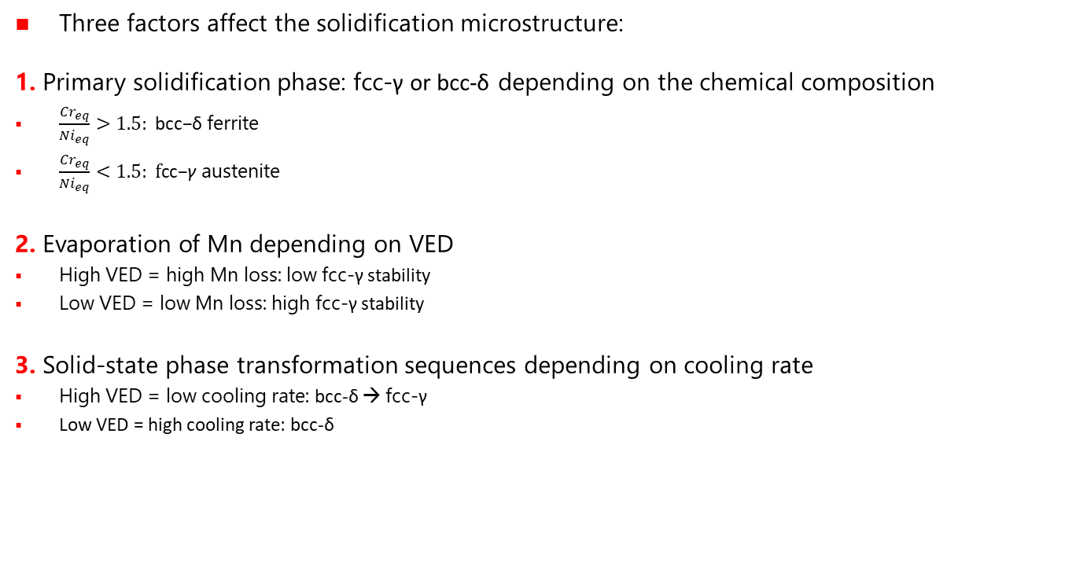


4. Microstructure control during laser powder bed fusion
Microstructure formation: effect of VED
Three factors affect the solidification microstructure:
1. Primary solidification phase: fcc-γ or bcc-δ depending on the chemical composition
$\frac{{Cr}_{eq}}{{Ni}_{eq}}>1.5: \text{bcc}\text{−}\text{δ}$ ferrite
$\frac{{Cr}_{eq}}{{Ni}_{eq}}<1.5: \text{f}\text{cc}\text{−}\text{γ}$ austenite
2. Evaporation of Mn depending on VED
High VED = high Mn loss: low fcc-γ stability
Low VED = low Mn loss: high fcc-γ stability
3. Solid-state phase transformation sequences depending on cooling rate
High VED = low cooling rate: bcc-δ → fcc-γ
Low VED = high cooling rate: bcc-δ
${Cr}_{eq}$/${Ni}_{eq}$> 1.5
${Cr}_{eq}$/${Ni}_{eq}<$ 1.5
Mn
Mn
Mn

Slide 4
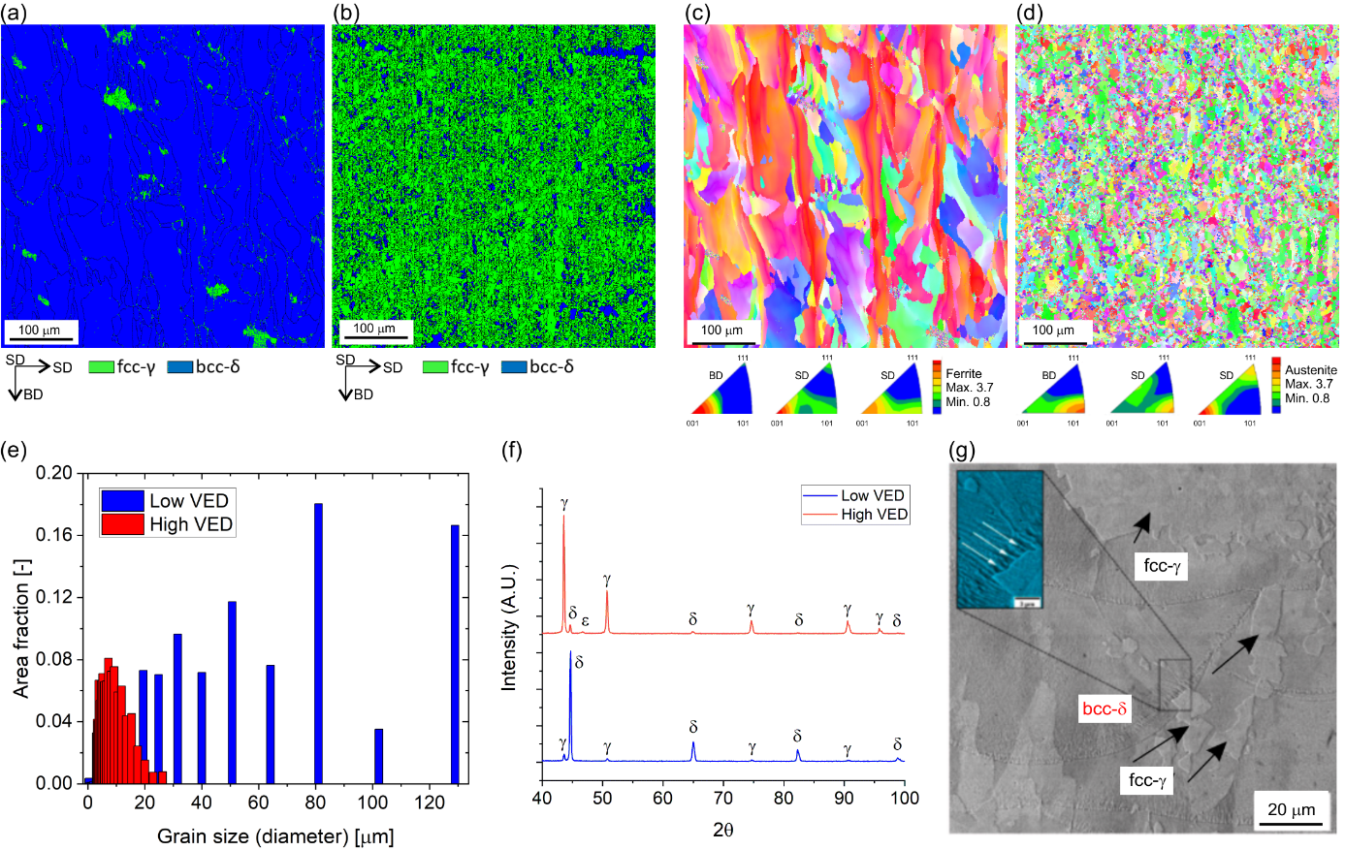
4. Microstructure control during laser powder bed fusion
Microstructure formation: effect of VED
Microstructure in w/oVC alloy:
1. Primary solidification phase: bcc-δ
2. Evaporation of Mn for high VED
3. bcc-δ → fcc-γ transformation for high VED
Microstructure in w/VC alloy:
1. Primary solidification phase: fcc-δ
2. Evaporation of Mn for high VED
3. bcc-δ → fcc-γ transformation for high VED
VED
VED
/I. Ferretto et al., Additive Manufacturing Letters 3 (2022) 100091/

Slide 5
4. Microstructure control during laser powder bed fusion
Microstructure formation: effect of VED
Different microstructure with VED
Grain size & morphology
Texture
Distinct strength and shape memory effect from different microstructures
Low VED
Shape memory
VED
?
High VED
Strength
/I. Ferretto et al., Additive Manufacturing Letters 3 (2022) 100091/

Slide 6
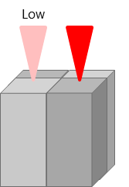
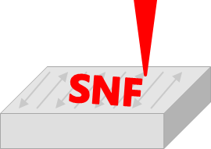
4. Microstructure control during laser powder bed fusion
Graded-microstructure samples
Variation of processing parameters on a local scale
Local variation of VED
Selective rescanning
Low VED
High VED
BD
BD
/I. Ferretto et al., submitted/

Slide 7
4. Microstructure control during laser powder bed fusion
Graded-microstructure samples
Variation of processing parameters on a local scale
Local variation of VED
Controlled Mn evaporation
Change in primary phase
Good combination of properties
/I. Ferretto et al., submitted/

Slide 8
4. Microstructure control during laser powder bed fusion
Graded-microstructure samples
Variation of processing parameters on a local scale
Local variation of VED
Controlled Mn evaporation
Change in primary phase
460
Hardness [HV]
Spatial modification of properties
320
0
Distance [mm]
7
/I. Ferretto et al., submitted/

Slide 9
4. Microstructure control during laser powder bed fusion
Graded-microstructure samples
Selective rescanning of different location and in different extent
Selective rescanning
1 mm spaced
Controlled Mn evaporation
Change in primary phase
0.25 mm spaced
Good combination of properties
/I. Ferretto et al., submitted/

Slide 10
4. Microstructure control during laser powder bed fusion
Graded-microstructure samples
Selective rescanning of different location and in different extent
Selective rescanning
1 mm spaced
Controlled Mn evaporation
Change in primary phase
Good combination of properties
/I. Ferretto et al., submitted/

Slide 11
4. Microstructure control during laser powder bed fusion
Graded-microstructure samples
Selective rescanning of different location and in different extent
/I. Ferretto et al., submitted/

Slide 12
Microstructure control in high-N steel
X7CrMnMoN 16-13-3 (Trade name: P2000)
Provided by Hempel Special Metals, Zürich
N-stabilized austenitic (fcc) stainless steel (contains ~0.7 wt.% N);
Why high-N steels?
  Ni-free, biocompatible
  Less expensive due to the low cost of nitrogen
  High strength (up to 3000 MPa) and more ductile than other steels with the same strength
Concern: N is lost during L-PBF,

Slide 13
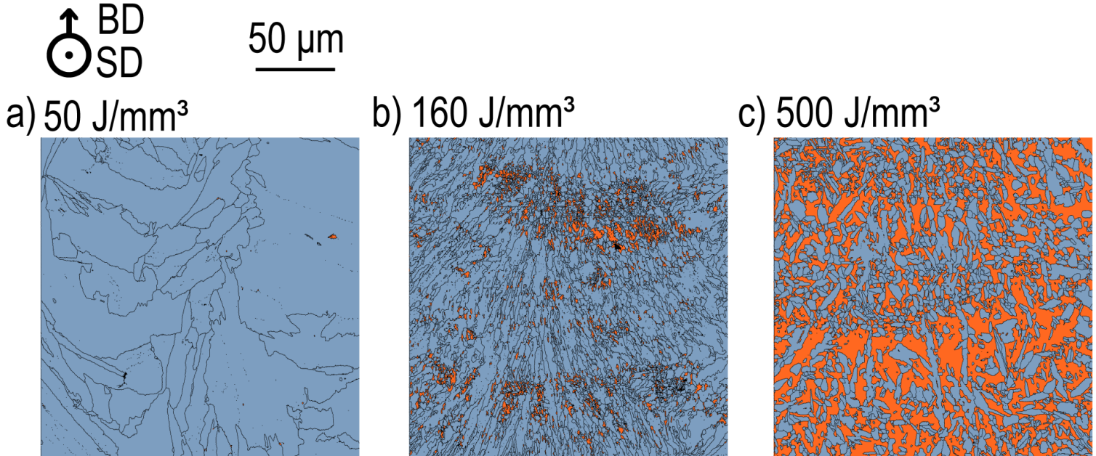

Microstructure control in high-N steel
Fabrication of dense parts at VED > 50 J/mm³
Microstructure and fraction of fcc/bcc phase can be manipulated by changing the VED (here: changing the laser power)
  At low VED: 100% fcc
  Amount of bcc increases with increasing VED
Blue: fcc
Red: bcc
/A. Arabi-Hashemi et al., Appl. Mater. Today 18 (2020) 100512/

Slide 14
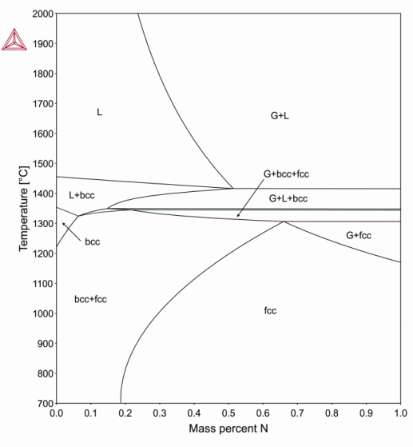
Microstructure control in high-N steel
Thermodynamic simulations including gas phase
Decreasing solubilty of N with increasing T
  Temperatures can easily exceed 2000°C locally
  Loss of N expected during melting
Amount of lost N will be depending on melt pool lifetime, i.e. melt pool size
The melt pool size is a function of VED
  Can the amount of lost N be controlled with the VED?
Fe-16Cr-13Mn-3Mo-0.07C-(0…1)N
/A. Arabi-Hashemi et al., Appl. Mater. Today 18 (2020) 100512/

Slide 15
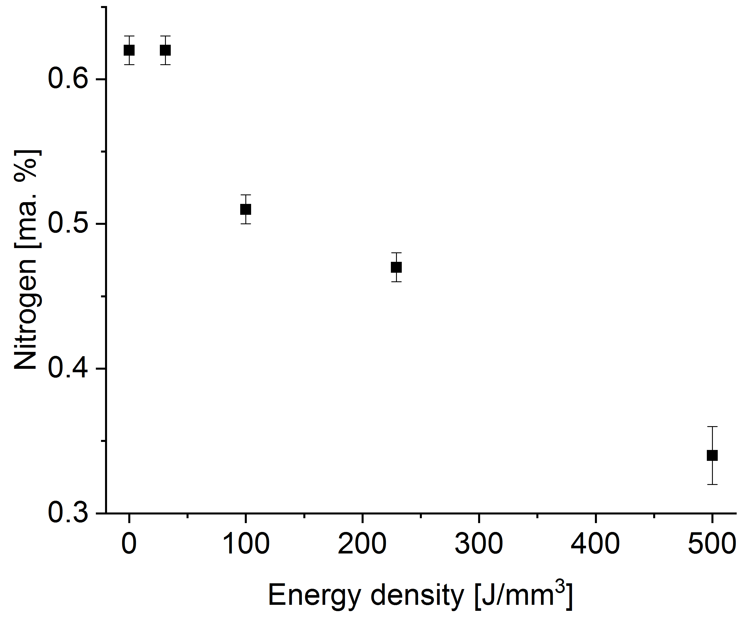
Microstructure control in high-N steel
Thermodynamic simulations including gas phase
Decreasing solubilty of N with increasing T
  Temperatures can easily exceed 2000°C locally
  Loss of N expected during melting
Amount of lost N will be depending on melt pool lifetime, i.e. melt pool size
The melt pool size is a function of VED
  Can the amount of lost N be controlled with the VED?
Rapid solidification leads to stabilization of fcc at higher N contents
/A. Arabi-Hashemi et al., Appl. Mater. Today 18 (2020) 100512/

Slide 16
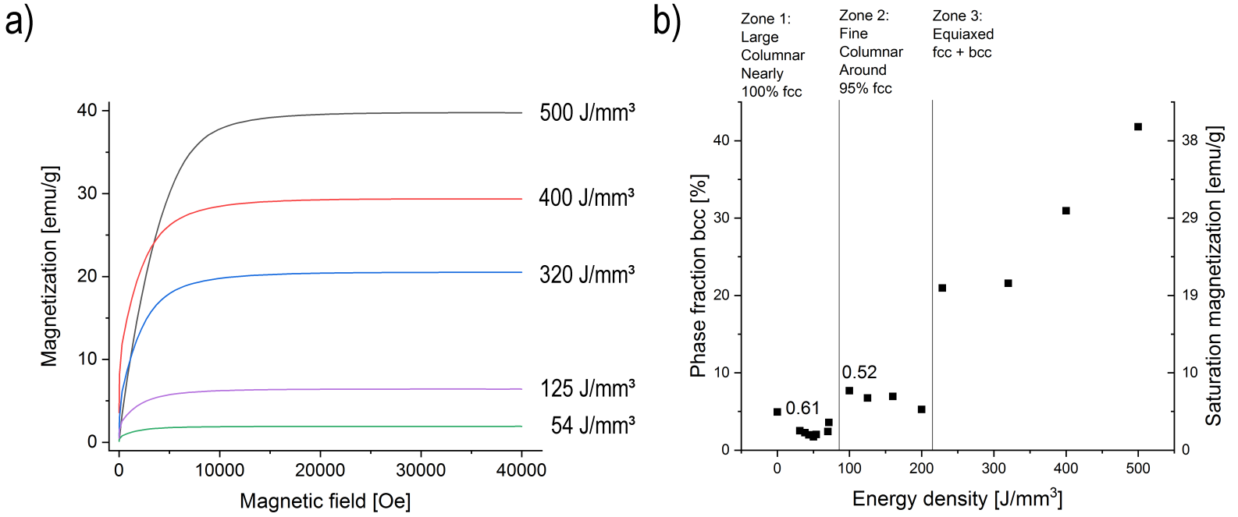
Microstructure control in high-N steel
bcc is ferromagnetic; fcc is paramagnetic
Magnetization is a function of amount of bcc
  Thus a function of amount of N
  Thus a function of VED
→ It is possible to adjust the magnetic properties during SLM!
/A. Arabi-Hashemi et al., Appl. Mater. Today 18 (2020) 100512/

Slide 17
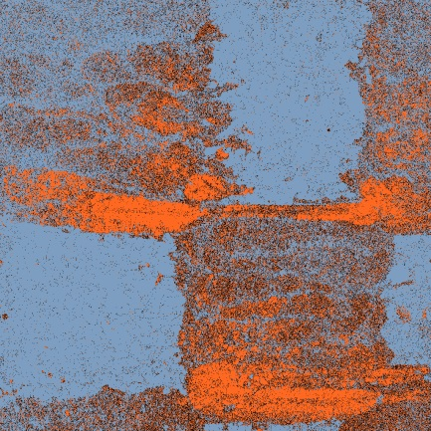

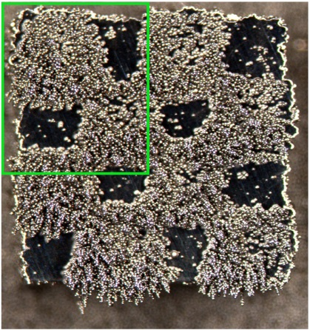
Microstructure control in high-N steel
3D magnetic patterning
Fabrication of a chess board pattern
  red: VED=500 J/mm3; blue: VED=50 J/mm3
Local control of bcc/fcc ratio and local grain microstructure
Possibility for 3D magnetic patterning in parts with intricate geometries
Blue: fcc
Red: bcc
Magnetized Fe powder reveals the chess board
/A. Arabi-Hashemi et al., Appl. Mater. Today 18 (2020) 100512/

